Slide 1

Mahatma Gandhi Vidyamandir’s
Arts, Science and Commerce College, Surgana
Library Orientation Programme
By
Sanjay D Mahajan
Librarian

Slide 2
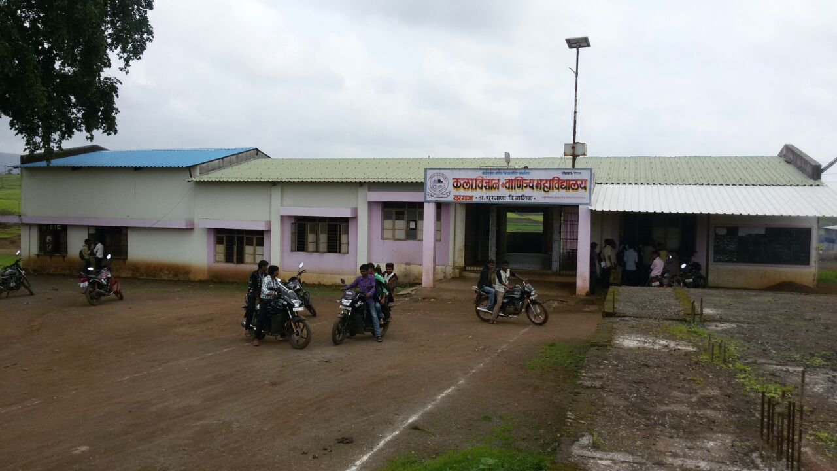
Mahatma Gandhi Vidyamandir’s
Arts, Science and Commerce College, Surgana
LIBRARY
Welcome
to
Library

Slide 3

INTRODUCTION
The Library was established with the establish of college in 1992 with minimum resources at present the library have 10221 books 18 journal&Magazines 01 Database(N-List 6000+ e-journals').
VISION:
As a center of intense intellectual inquiry, the Library shares with college the aspiration to be an intelligent hub of teaching, learning, research, and invention among students, faculty and staff
MISSION:
To actively support to the teaching, learning and research activities of the college by providing the access to the information sources .

Slide 4

AIMS AND OBJECTIVES OF LIBRARY
To provide the information sources for teaching , learning and research activities.
To provide easy internet access to students and faculty.
To provide best library services to the users.
To take steps to meet the challenges in ICT era.

Slide 5
Library as Learning Resources
Central Library
Total area:
142.23 Sq.m.
Working hours: 09.30 am to 05.30 pm
Reading room: 1
Seating capacity: 50

Slide 6
LIBRARY ADVISORY COMMITTEE
Sr. No. | Name of the Member | Designation
1 | Dr. A. V. Patil ( Principal) | Chairman
2 | Dr. V. D. Ahire (Vice Principal) | Member
3 | Dr. Agnesh Kaharat ( IQAC Cordinator)
4 | Dr. R. K. Binniwale (Asst. Prof.) | Member
5 | Prof. S. R. Pawade (Asst. Prof.) | Member
6 | Dr. D. G. Kapadnis (Asst. Prof.) | Member
7 | Shri. S. A. Gite (Accountant) | Member
8 | Shri. S.D. Mahajan (Librarian) | Secretary

Slide 7
INFRASTRUCTURE
Total Area of the Library: 79.73 Sq.m ( Ground floor)
62.50 Sq.m ( First floor)
Ground Floor: Library office, Book acquisition and processing section,
OPAC, Property Counter, Circulation section,
Text book section, Reference section. Periodical section.
First Floor: Reading hall, Internet facility,

Slide 8
LIBRARY WORKING HOURS
SECTION | TIME | DAYS
Reading Hall | 8. 00 am to 5.30pm | on all the working days,
Office/Circulation/ Reference and Text Book Section | 8.00 am to 5.30 pm | on all the working days

Slide 9
YEARWISE ADDITION IN THE LIBRARY COLLECTION
COLLECTION | YEAR
 | 2011-2012 | 2012-2013 | 2013-2014 | 2014-2015 | 2015-2016 | 2016-2017
No. of Books | 1305 | 717 | 960 | 975 | 585 | 261
Spend Amount (Rs) | 4,99,890.16 | 1,85,629.00 | 1,72,963.00 | 2,60,329.50 | 1,21,158.00 | 54,399.00

Slide 10
LIBRARY COLLECTION
COLLECTION | NUMBER | Total Collection
Text Books | 7649 | 11023
Reference Books | 3374
Journals & Magazine | 18 | 18
News Paper | 6 | 6
CD/ DVD | 12 | 12

Slide 11
E-RESOURCES COLLECTION( Subscribed / Purchased)
COLLECTION | NUMBER
E-Books | 300000+
E-Journals | 6000+
CD/ DVD | 12
Total | 306012
E-RESOURCES COLLECTION (Free)
COLLECTION
Digital Library of India
NISCAIR
DOAJ
OALIB Etc.

Slide 12
LIBRARY SERVICES
Circulation of books (1 book for 7 days to students)
Reference Service
Photocopy Service
Newspaper Clipping
ILL (Inter Library Loan)
ONLINE SERVICES
Library website,
Institutional Repository
E-Resources (Under N-List )
E-Resources (Free & Open Source)
DDS (Document Delivery Service) using social media
CAS (Current Awareness Service ) using social media

Slide 13
PRESENT STAFF OF THE LIBRARY - 02
Librarian - 01
Library Attendant - 01
LIBRARY USERS
REGISTERED MEMBERS | 2016-17 | 2017-18
a) PG Students | 110
b) UG Students | 1859
b) Teaching Staff | 28
c) Nonteaching Staff | 14

Slide 14
Extension Activities
Library orientation to fresher's
User awareness program.
Book exhibitions on various occasions
Individual Guidance about Carrier & Life Skill to Students

Slide 15
INNOVATIVE PRACTICES
Identity card: faculty and students
Students participation through earn and learn scheme for library work
DDS (Document Delivery Service) using social media
CAS (Current Awareness Service ) using social media
Institutional repository
Separate library website

Slide 16
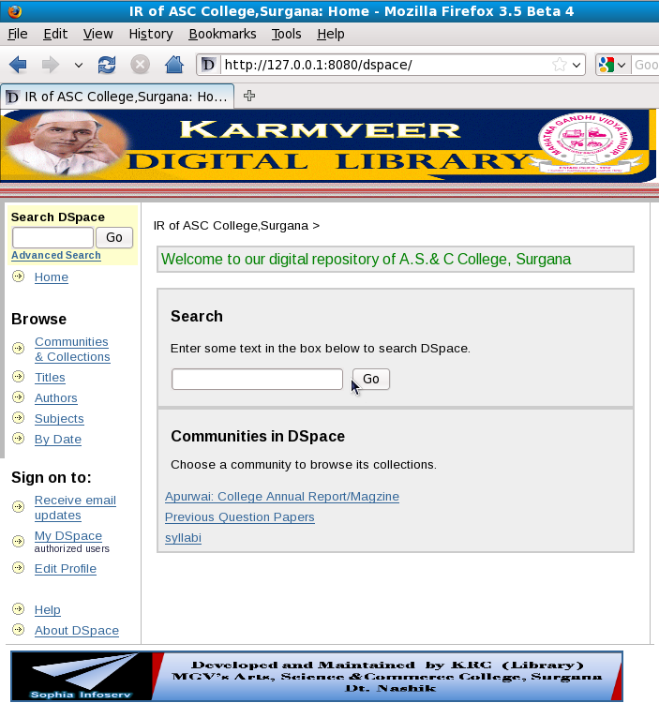
Institutional Repository

Slide 17
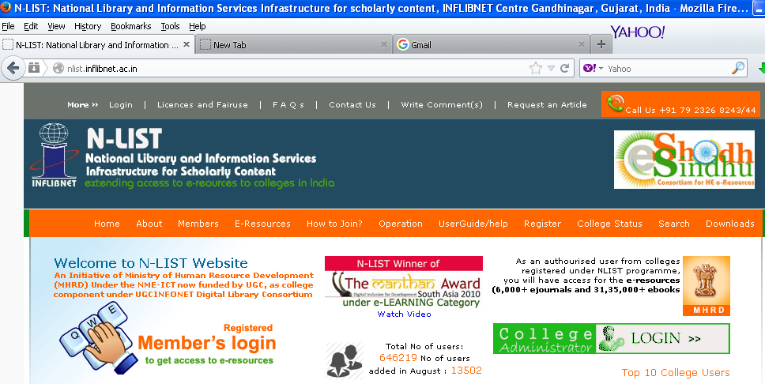
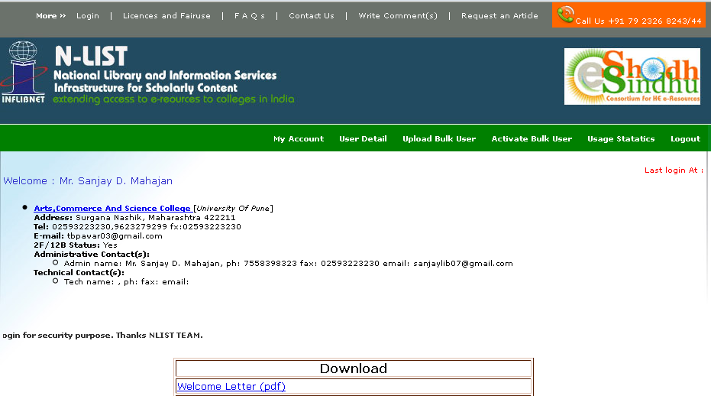
N-List Database(E-Journals &E-Books)
http://nlist.inflibnet.ac.in/

Slide 18
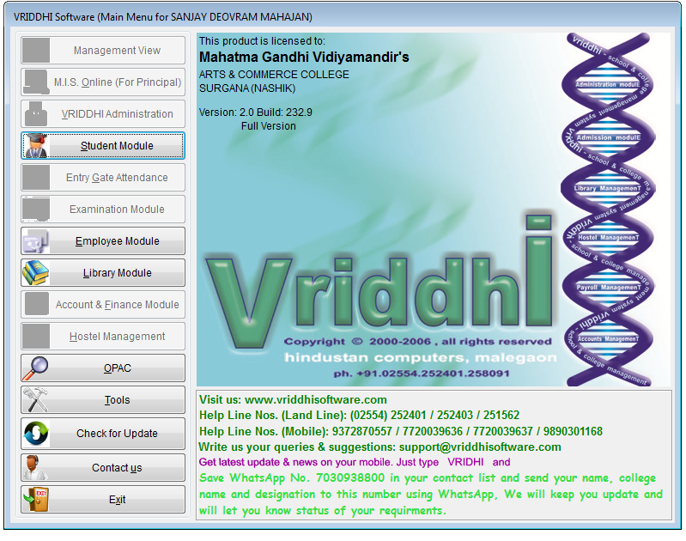
Vriddhi Software used for Library automation

Slide 19
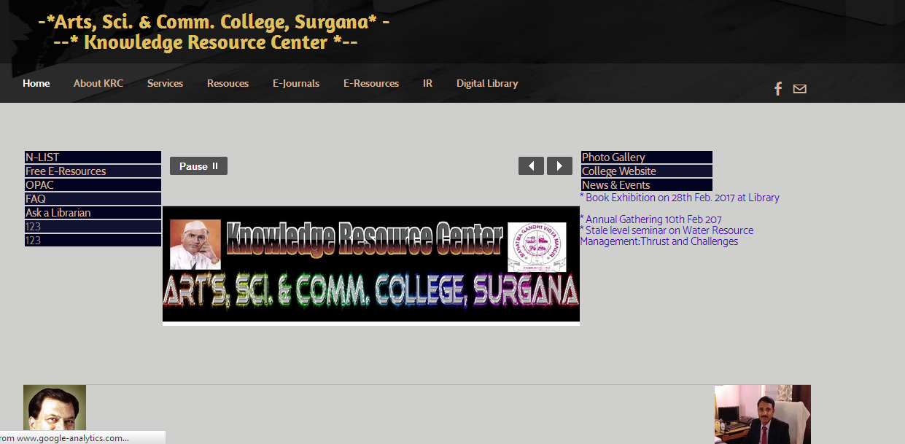
LIBRARY WEBSITE
www.asccskrc.wordpress.com

Slide 20
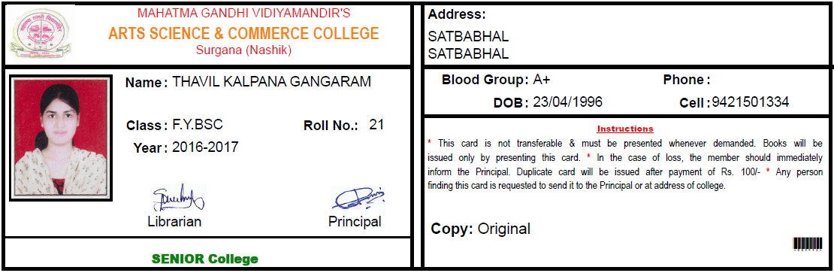
I D CARD GENERATED BY THE LIBRARY

Slide 21
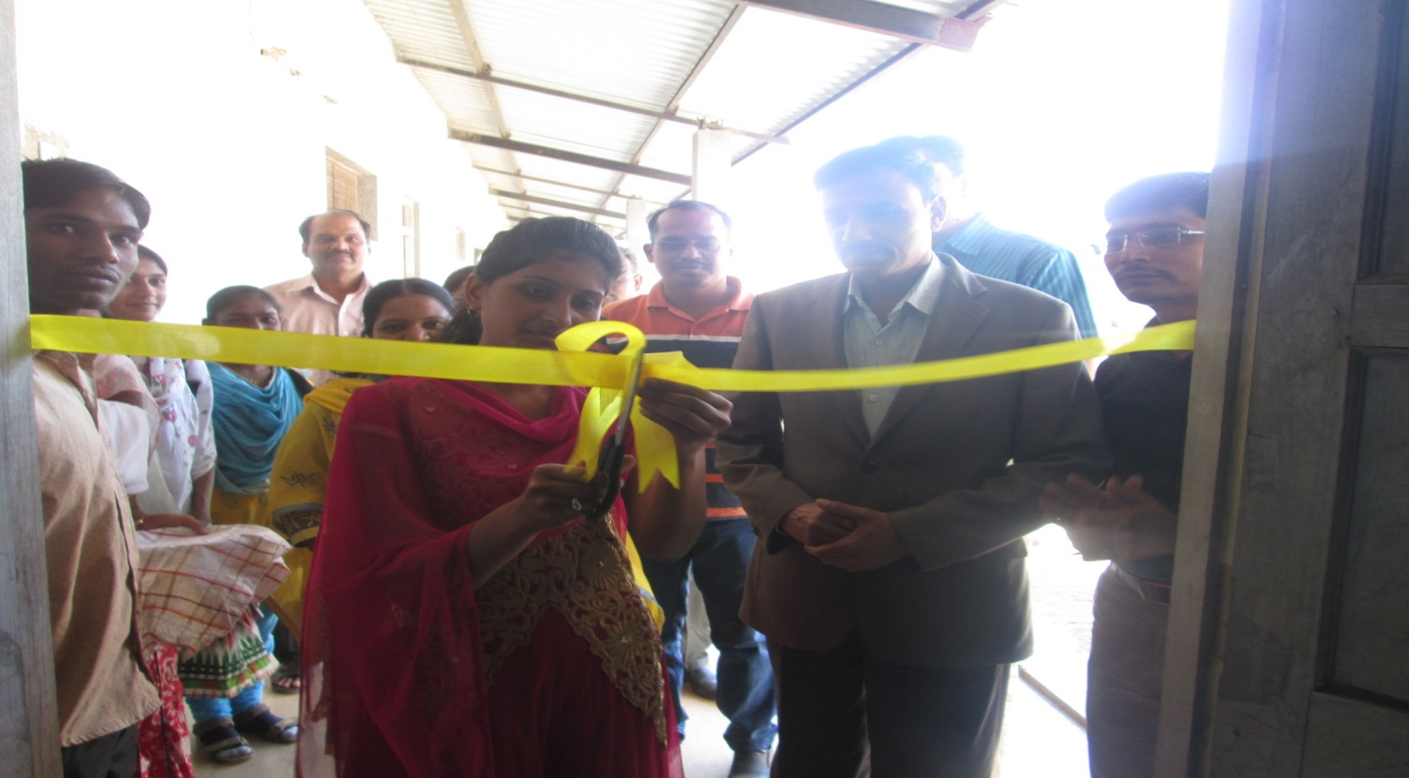
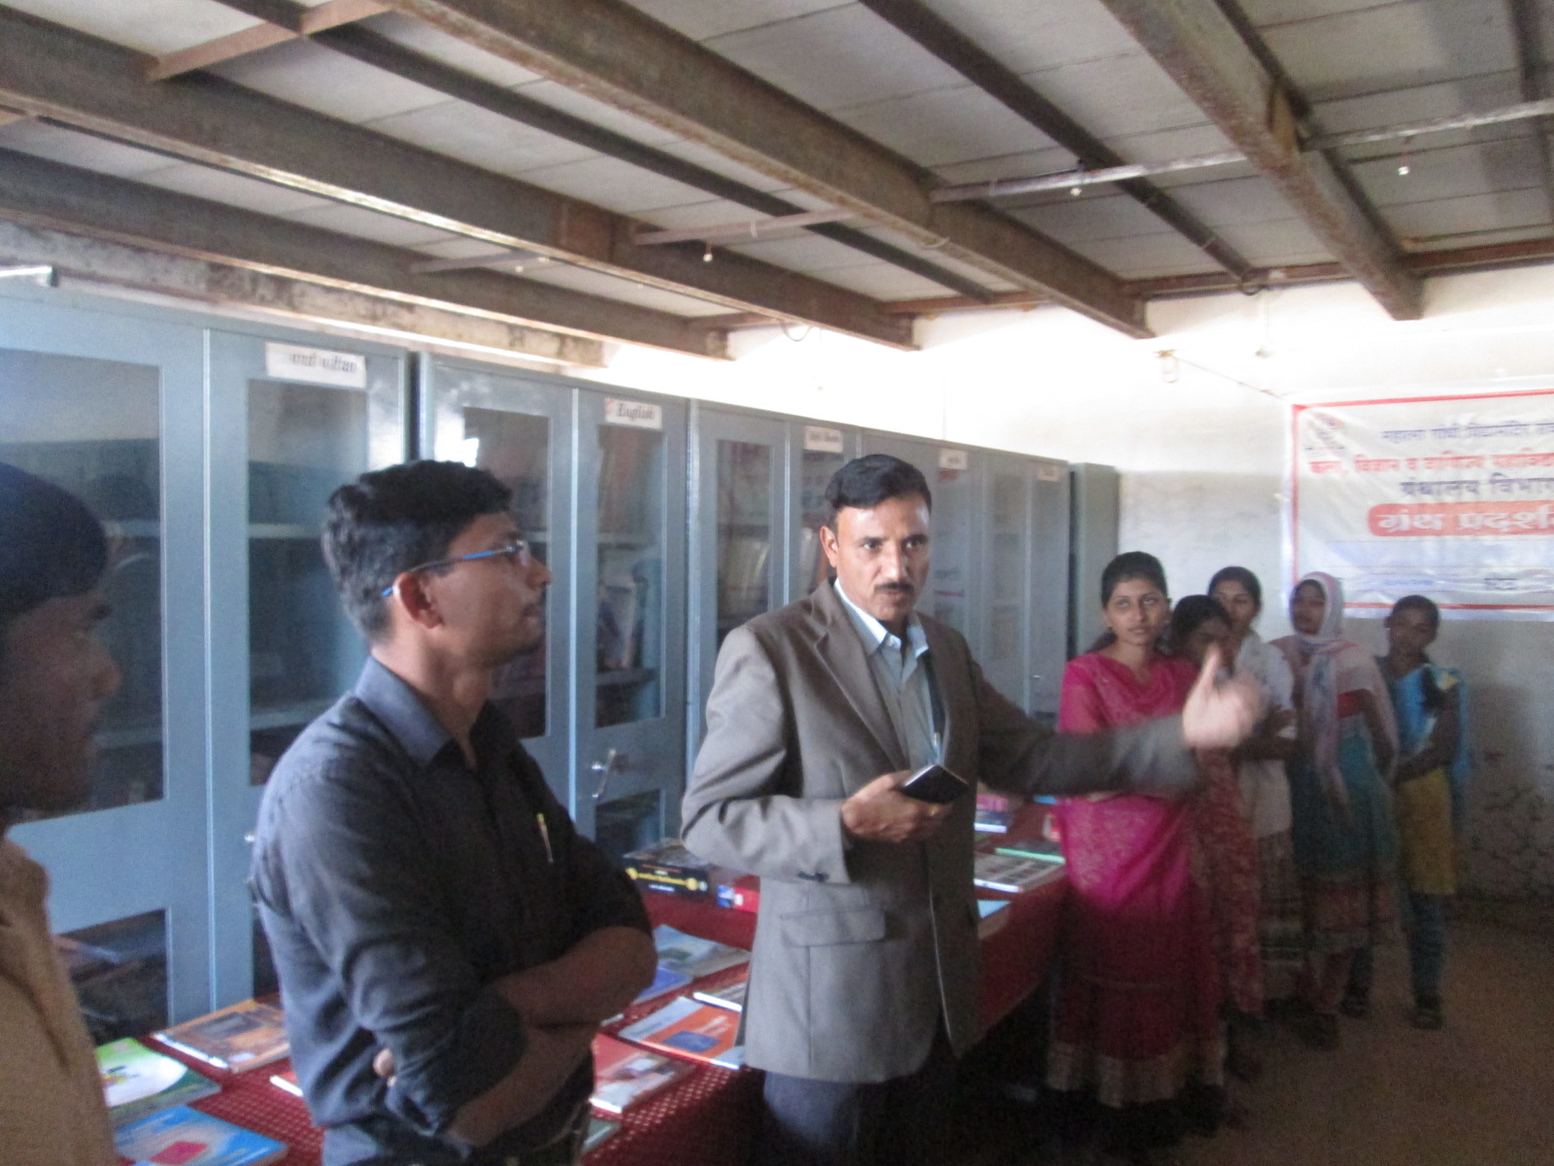
Book Exhibition
28th Feb . National Science Day

Slide 22
FUTURE PLANS OF THE LIBRARY
To develop a green library
To make a digital library
Upgrade Institutional Repository
To construct separate library building

Slide 23
Thank
You

